Slide 1

CE101 Engineering Drawing Lec4: Orthographic Projections Points, Lines & Traces
Indian Institute of Technology Guwahati

Slide 2
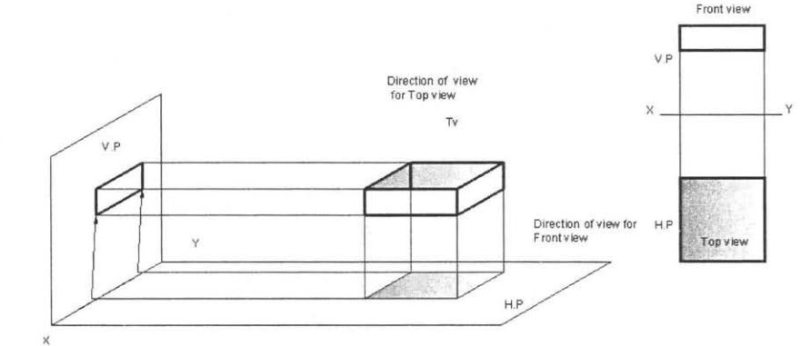
Projection
The task of recording the shapes and sizes of 3-D objects on 2-D drawings in done using Projections.
Orthographic projection: When the projectors are parallel to each other and also perpendicular to the plane, the projection is called orthographic projection.
Method of obtaining orthographic views (top view and front view)

Slide 3
To draw projections of any object, one must have following information:
A) OBJECT
{With its description, well defined}
B) OBSERVER
{Always observing perpendicular to resp. Ref. Plane}
C) LOCATION OF OBJECT
{Means its position with reference to H.P. & V.P.}

Slide 4
NOTATIONS
Following notations should be followed while naming
Different views in orthographic projections.
OBJECT POINT A LINE AB
IT’S TOP VIEW a a b
IT’S FRONT VIEW a´ a´ b´
IT’S SIDE VIEW a´´ a´´ b´´
Same system of notations should be followed
incase numbers, like 1, 2, 3 – are used.
TERMS ‘ABOVE’ & ‘BELOW’ WITH RESPECT TO H.P.
TERMS ‘IN FRONT’ & ‘BEHIND’ WITH RESPECT TO V.P.

Slide 5
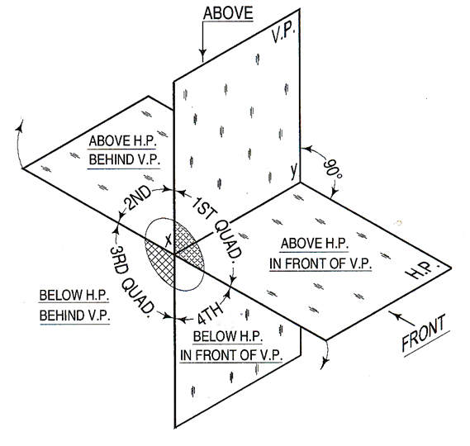

Slide 6
2nd Quadrant
VP
2nd Quad.
1ST Quad.
F.V.
1st Quadrant
Y
Observer
X Y
HP
X
3rdQuadrant
Observer
3rd Quad.
4th Quad.
4th Quadrant
This quadrant pattern, if observed along x-y line (in red arrow direction) will exactly appear as shown on right side and hence it is further used to understand illustration properly.

Slide 7
POINT A IN
2ND QUADRANT
VP
POINT A IN
1ST QUADRANT
VP
a´
A
Point A is placed In
different quadrants
and it’s FV & TV are brought in same plane for observer to see clearly.
FV is visible as it is a view on VP. But as TV is is a view on HP, it is rotated
downward 90⁰, in clockwise direction. The front part of HP comes below XY line and the part behind VP
comes above.
A
a´
a
HP
OBSERVER
HP
OBSERVER
a
a
HP
HP
OBSERVER
OBSERVER
a
a´
A
a´
POINT A IN
3RD QUADRANT
A
POINT A IN
4TH QUADRANT
VP
VP
Notes:
A Point Represent a location in the space.
Dimensionless geometrical entity which has position but no magnitude.
Projection of points have no practical significance, it serves the basis for the projection of lines , planes and solids.

Slide 8
PROJECTIONS OF A POINT IN FIRST QUADRANT
POINT A ABOVE HP
& IN FRONT OF VP
POINT A ABOVE HP
& IN VP
POINT A IN HP
& INFRONT OF VP
For TV
For TV
PICTORIAL
PRESENTATION
PICTORIAL
PRESENTATION
For TV
a´
a´
A
A
For FV
Y
Y
Y
For FV
a
a´
X
a
a
X
X
A
For FV
ORTHOGRAPHIC PRESENTATIONS
OF ALL ABOVE CASES.
FV above XY,
TV below XY.
FV above XY,
TV on XY.
FV on XY,
TV below XY.
VP
VP
VP
a´
a´
X
Y
X
Y
X
a´
Y
a
a
a
HP
HP
HP

Slide 9
EXAMPLE PROBLEMS ON POINTS
PROBLEM:
A point A is 20 mm above HP and 30 mm in front of VP. Draw its projections
Solution steps:
Draw reference line XY.
Mark a point a´ at a distance of 20 mm above XY.
Through this point draw a perpendicular line to XY and mark the top view a at a distance of 30 mm below XY.
VP
Orthographic projection
30
A
a´
a´
20
Y
HP
20
X
Y
a
X
30
a
a

Slide 10
PROBLEM:
Draw the projections of the following points on the same ground line, keeping the distance between projectors equal to 25 mm.
Point A, 20 mm above HP, 25 mm behind VP;
(ii) Point B, 25 mm below HP, 20 mm behind VP;
Point C, 20 mm below HP, 30 mm in front of VP;
(iv) Point D, 20 mm above HP, 25 mm in front of VP;
(v) Point E, on HP, 25 mm behind VP;
(vi) Point F, on VP, 30 mm above HP;
Solution:
f´
e
a
b
d
a´
30
25
`
20
25
20
20
X
e´
f
Y
20
25
30
25
c´
b´
d´
c

Slide 11
PROJECTIONS OF STRAIGHT LINES
INFORMATION REGARDING A LINE MEANS:
It’s length
Position of it’s ends with HP & VP
It’s inclinations with HP & VP will be given.
AIM:- To draw it’s projections - means FV & TV.
SIMPLE CASES OF THE LINE
A vertical line (line perpendicular to HP & parallel to VP)
Line parallel to both HP & VP.
Line inclined to HP & parallel to VP.
Line inclined to VP & parallel to HP.
Line inclined to both HP & VP.
Notes:
A straight line is the shortest distance between any two points in space.
1-D entity, only length no thickness.

Slide 12
For TV
Orthographic Pattern
(Pictorial Presentation)
V.P.
a´
Note:
FV is a vertical line
Showing True Length
&
TV is a point.
a´
1.
V.P.
A
FV
FV
A line
perpendicular
to HP
&
parallel to VP
b´
b´
Y
X
Y
B
For FV
TV
a (b)
X
TV
a (b)
H.P.
Orthographic Pattern
(Pictorial Presentation)
Note:
FV & TV both are
// to XY
&
both show T. L.
V.P.
For TV
2.
a´
FV
b´
A line
// to HP
&
// to VP
V.P.
F.V.
b´
B
a´
A
Y
X
Y
For FV
b
a
b
T.V.
TV
X
a
H.P.

Slide 13
FV inclined to XY TV parallel to XY
V.P.
3.
V.P.
b´
b´
A line inclined to HP
and
parallel to VP
(Pictorial presentation)
F.V.
B
F.V.
a´
θ
θ
Y
a´
θ
X
Y
A
b
a
T.V.
b
X
T.V.
a
H.P.
Orthographic Projections
TV inclined to XY FV parallel to XY
V.P.
4.
V.P.
FV
A line inclined to VP
and
parallel to HP
(Pictorial presentation)
F.V.
b´
a´
b´
a´
A
Ø
B
X
Y
a
Ø
Ø
b
TV
a
T.V.
b
H.P.

Slide 14
Parallel to VP and inclined to HP
PROBLEM:
A straight line AB of 40 mm length has one of its ends A, at 10 mm from the HP and 15 mm from the VP. Draw the projections of the line if it is parallel to the VP and inclined at 30° to the HP. Assume the line to be located in each of the four quadrants by turns.
b´
40
b´
a´
30°
10
a
30°
b
X
Y
15
15
a´
10
a
( Quadrant 1)
b
X
(Quadrant 2)
Y
a
b
X
Y
15
10
a´
15
X
Y
10
a
b
30°
a´
30°
(Quadrant 4)
b´
(Quadrant 3)
b´

Slide 15
For TV
For TV
5.
A Line inclined to both
HP and VP
(Pictorial presentation)
b´
b´
V.P.
V.P.
B
F.V.
B
F.V.
α
α
Y
Y
On removal of object
i.e. Line AB
FV as a image on VP.
TV as a image on HP,
a´
a´
For FV
For FV
A
A
β
X
β
X
a
T.V.
b
a
T.V.
b
V.P.
b´
FV
a´
α
Orthographic Projections
FV is seen on VP clearly.
To see TV clearly, HP is rotated 90⁰ downwards,
Hence it comes below XY.
X
Y
Note:-
Both FV & TV are inclined to XY.
(No view is parallel to XY)
Both FV & TV are reduced lengths
(No view shows True Length)
a
β
TV
H.P.
b
Notes:
Note that , when the line is inclined to the HP at theta and parallel to VP, then in the F.V. the line is inclined at the same angle ‘theta’. But when the line is inclined to both H.P and V.P. , then the F.V. and the T.V. are also inclined in the orthographic projection but their inclinations are now ‘alpha’ and ‘beta’ AND not ‘theta’ and ‘phi’.

Slide 16
Orthographic Projections
Means FV & TV of Line AB
are shown below, with their apparent inclinations α & β
Note the procedure
When FV & TV known,
How to find True Length.
(Views are rotated to determine
True Length & it’s inclinations
with HP & VP).
Note the procedure
When True Length is known,
How to locate FV & TV.
(Component a-1 of TL is drawn
which is further rotated
to determine FV)
V.P.
V.P.
V.P.
b´
b´
b₁´
b´
b₁´
FV
FV
Fv
TL
a´
α
TL
a´
θ
α
1´
a´
θ
X
X
Y
Y
X
Y
1
a
β
a
β
b₂
a
Ø
TV
β
TV
TV
TV
TL
H.P.
b
H.P.
b
H.P.
b
b₁
In this sketch, TV is rotated
and made // to XY line.
Hence it’s corresponding
FV, a’ b₁’ is showing
True Length
&
True Inclination with HP.
Here a -1 is component
of TL ab₁ gives length of FV.
Hence it is brought upto
Locus of a’ and further rotated
to get point b’. a’ b’ will be FV.
Similarly drawing component
of other TL (a’ b₁‘) TV can be drawn.
Here TV (ab) is not // to XY line
Hence it’s corresponding FV
a’ b’ is not showing
True Length &
True Inclination with HP.

Slide 17
1) True Length (TL) – a’ b₁’ & a b₁
Diagram showing graphical relations
among all important parameters of this topic.
2) Angle of TL with HP -
θ
TEN important
parameters
to be remembered
with notations
used here onward
3) Angle of TL with VP –
Ø
4) Angle of FV with XY –
α
β
V.P.
5) Angle of TV with XY –
Distance between
End Projectors.
6) LTV (length of FV) – Component (a-1)
b´
b₁´
7) LFV (length of TV) – Component (a’-1’)
8) Position of A- Distances of a & a’ from XY
FV
9) Position of B- Distances of b & b’ from XY
TL
α
10) Distance between End Projectors
a´
θ
1´
LTV
NOTE
θ
α
Construct with a’
X
Y
&
a
LFV
1
Ø
&
β
Construct with a
Ø
b’ & b₁’ on same locus.
β
b & b₁ on same locus.
TV
TL
Also remember
H.P.
b
b₁
True Length is never rotated. It’s horizontal component is drawn & it is further rotated to locate view.
Views are always rotated, made horizontal & further extended to locate TL, θ & Ø

Slide 18
INCLINED TO HP & VP
PROBLEM 7:
Line AB is 75 mm long and it is 30⁰ & 40⁰ inclined to HP & VP respectively. End A is 12mm above HP and 10 mm in front of VP. Draw projections. Line is in 1st quadrant.
b´
b´₁
Solution steps:
1) Draw XY line and one projector.
2) Locate a´ 12mm above XY line
& a 10mm below XY line.
3) Take 30⁰ angle from a´ & 40⁰ from a and mark TL, i.e., 75mm on both lines. Name those points b₁´ and b₁ respectively.
4) Draw horizontal component of TL a b₁ from point b₁ and name it 1. (the length a-1 gives length of FV as we have seen already)
5) Extend it up to locus of a and rotating a’ as center locate b´ as shown. Join a´ b´ as FV.
6) From b´ drop a projector downward & get point b. Join a & b, i.e., TV.
FV
TL
θ
a´
X
Y
a
LFV
1
Ø
TV
TL
b
b₁
Notes:
See this slide method only to find the FV and TV if the true length and its actual inclinations are given.

Slide 19
FINDING INCLINATION WITH HP
PROBLEM 8:
Line AB 75mm long makes 45⁰ inclination with VP while it’s FV makes 55⁰. End A is 10 mm above HP and 15 mm in front of VP. If line is in 1st quadrant draw it’s projections and find it’s inclination with HP.
Solution Steps:-
1.Draw xy line.
2.Draw one projector for a’ & a
3.Locate a´ 10mm above XY & a 15 mm below XY.
4.Draw a line 45⁰ inclined to XY from point a and cut TL 75 mm on it and name that point b_{1.}
5.Draw locus from point b_{1.}
6.Take 55⁰ angle from a´ for FV above XY line.
7.Draw a vertical line from b₁ up to locus of a and name it 1. It is horizontal component of
TL & is LFV.
8.Continue it to locus of a´ and rotate upward up to the line of FV and name it b´. This a´ b´ line is FV.
9. Drop a projector from b´ on locus from point b₁ and name intersecting point b. Line ab is TV of line ab.
10.Draw locus from b´ and with TL distance cut point b₁´
11.Join a´ b₁´ as TL and measure it’s angle α at a´. It will be true angle of line with HP.
b´
b´ ₁
LOCUS OF b₁´
FV
TL
55⁰
α
a´
X
Y
a
LFV
1
45⁰
TV
TL
LOCUS OF b₁
b
b₁
Notes:
Note that the locus of b and b1 is same and the locus of b1’ and b’ is same.

Slide 20
FINDING TL AND INCLINATIONS
PROBLEM 9: FV of line AB is 50⁰ inclined to XY and measures 55 mm long while it’s TV is 60⁰ inclined to XY line. If end A is 10 mm above HP and 15 mm in front of VP, draw it’s projections, find TL, inclinations of line with HP & VP.
b’
b’₁
Solution steps:
1.Draw XY line and one projector.
2.Locate a’ 10 mm above XY and a 15 mm below XY line.
3.Draw locus from these points.
4.Draw FV 50⁰ from a’ and
mark b’ cutting 55mm on it.
5.Similarly draw TV 60⁰ from a & drawing projector from b’
locate point b and join a b.
6.Then rotating views as shown, locate True Lengths ab₁ & a’b₁’ and their angles with HP and VP.
FV
TL
50⁰
a’
X
Y
a
60⁰
TV
TL
b
b₁
Notes:
After getting the first true length, take dist ab1 on compass and keeping the compass at a’, cut an arc on the locus of b’.

Slide 21
FINDING ANGLE WITH HP & VP
PROBLEM 10:-
Line AB is 75 mm long. It’s FV and TV measure 50 mm & 60 mm long respectively. An end is 10 mm above HP and 15 mm in front of VP. Draw projections of line AB if end B is in first quadrant. Find angle with HP and VP.
b’
b’₁
SOLUTION STEPS:
1.Draw XY line and one projector.
2.Locate a’ 10 mm above XY and
a 15 mm below XY line.
3.Draw locus from these points.
4.Cut 60mm distance on locus of a’
& mark 1’ on it as it is LTV.
5.Similarly cut 50mm on locus of a
and mark point 1 as it is LFV.
6.From 1’ draw a vertical line upward
and from a’ taking TL (75mm ) in
compass, mark b’₁ point on it.
Join a’ b’₁ points.
7. Draw locus from b’₁
8. With same steps below get b₁ point
and draw also locus from it.
9. Now rotating one of the components
i.e., a-1 locate b’ and join a’ with it
to get FV.
10. Locate TV similarly and measure
angles
FV
TL
θ
LTV
1’
a’
X
Y
a
LFV
Φ
1
TV
TL
θ and Φ
b
b₁
Notes:
Imp question and nice method

Slide 22
FINDING ANGLE WITH HP & VP
PROBLEM 10:- TV of a 75 mm long line CD, measures 50 mm. End C is in HP and 50 mm in front of VP. End D is 15 mm in front of VP and it is above HP. Draw projections of CD and find angles with HP and VP.
SOLUTION STEPS:
d’
d’₁
LOCUS OF d’
1.Draw XY line and one projector.
2.Locate c’ on XY and c 50mm below XY line.
3.Draw locus from these points.
4.Draw locus of d 15 mm below XY.
5.Cut 50mm & 75 mm distances on
locus of d from c, and mark points
d & d₁ as these are TV and TL. Join both with c.
6.From d₁ draw a vertical line upward up to XY i.e., up to locus of c’ and draw an arc as shown.
7 Then draw one projector from d to meet this arc in d’ point & join c’ d’
8. Draw locus of d’ and cut 75 mm
on it from c’ as TL
9.Measure angles
FV
TL
c’
θ
X
Y
d
d₁
LOCUS OF d
TL
TV
θ and Φ
Φ
c
Notes:
My method:
Draw LTV from c’ as in the previous question.
Draw a perpendicular to the locus of c from the point of LTV upwards.
Take an arc of 75 , and place the point of compass on c’ and cut an arc on the perpendicular drawn before .
Thus we get the upper true length.
Then we can draw all the other lengths.
Remember: d,d1 lie on the same locus

Slide 23
TRACES OF A LINE
A trace is a point at which the line or its extension meets the HP or the VP.
Horizontal Trace (HT) The point of intersection of the line (or its extension) with the HP is called the horizontal trace of the line. The HT is always seen on TV or extension of TV, the projection of the HT on the XY line is indicated by h.
A line will show an HT if it is inclined to the HP.
VT
HT
VT
HT
HT
HT
VT
VT

Slide 24
Vertical Trace (VT) The point of intersection of the line (or its extension) with the VP is called the vertical trace of the line. VT is always seen on FV or extension of FV., the projection of the VT on the XY line is indicated by v.
A line will show a VT if it is inclined to the VP.
A line parallel to both the RPs will have no trace.
The terms h-HT and v-VT may be used to indicate the distances of the HT and the VT respectively from the RPs.
VT
HT
VT
HT
HT
HT
VT
VT
24
Notes:
h-HT is the distance between h and HT.
Similarly for v-VT.

Slide 25
TRACES OF THE LINE:-
These are the points of intersections of a line ( or it’s extension ) with respect to reference planes.
A line itself or its extension, where ever touches H.P., that point is called TRACE OF THE LINE ON H.P. (It is called H.T.)
Similarly, a line itself or it’s extension, where ever touches V.P., that point is called TRACE OF THE LINE ON V.P. (it is called V.T.)
V.T.:- It is a point on VP.
Hence it is called FV of a point in VP.
Hence it’s TV comes on XY line.( Here onward denoted as ‘v’)
H.T.:- It is a point on HP.
Hence it is called TV of a point in HP.
Hence it’s FV comes on XY line.( Here onward denoted as ‘h’ )

Slide 26
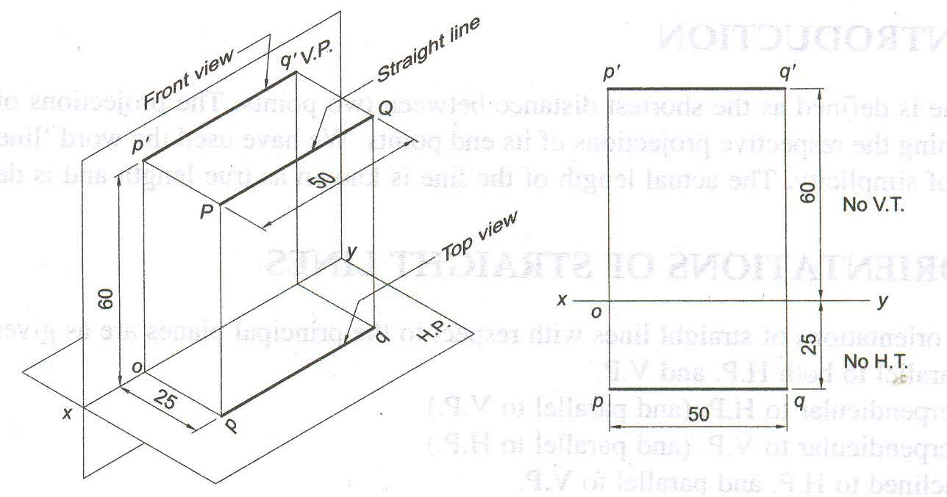
Line Parallel to both HP and VP and its traces

Slide 27
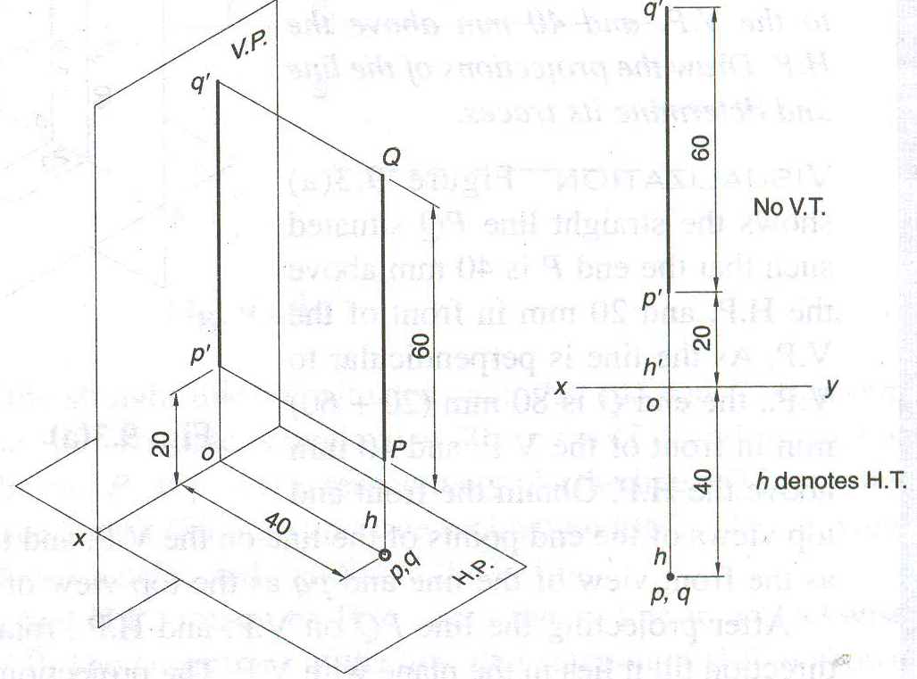
Line Parallel to VP and Perpendicular to HP and its traces

Slide 28
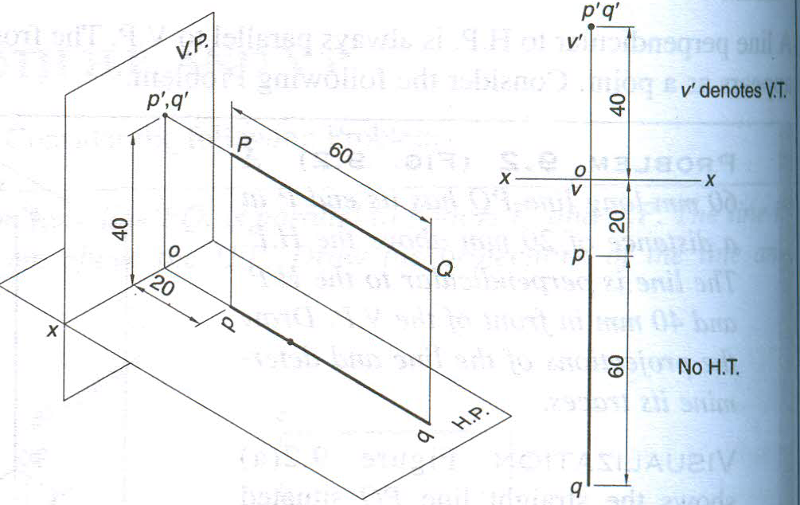
Line Parallel to HP and Perpendicular to VP and its traces
Notes:
HT is denoted by h’ and V.T. by v’

Slide 29
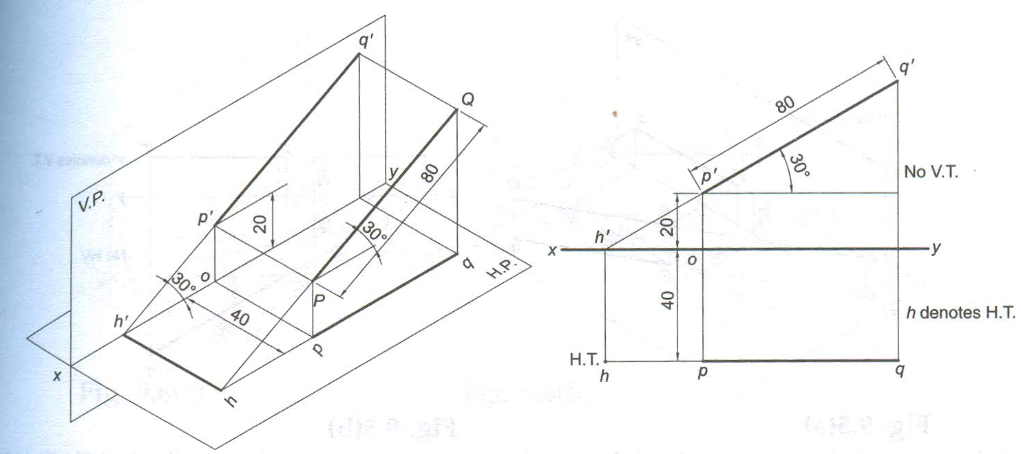
Line Parallel to VP and Inclined to HP and its traces
Notes:
Note: h’ and h lie on the same projection line

Slide 30
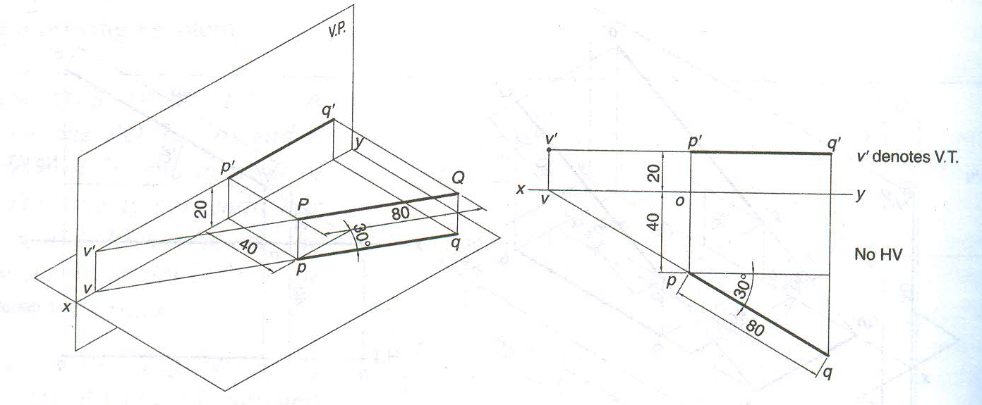
Line Parallel to HP and Inclined to VP and its traces
No HT

Slide 31
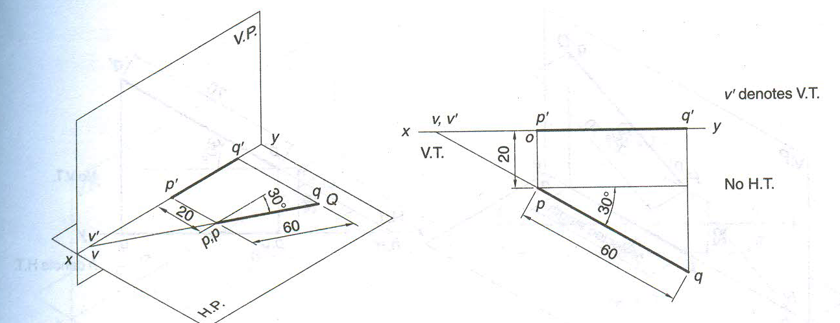
Line Lies on HP and Inclined to VP and its traces

Slide 32
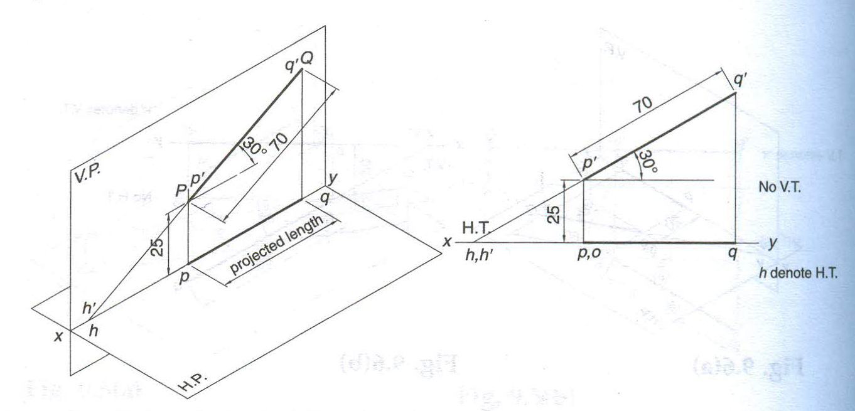
Line Lies on VP and Inclined to HP and its traces

Slide 33
For TV
Line inclined to both VP and HP
b’
b´
FV
B
a’
a´
Y
x
v
h’
Y
V.P.
h'
VT
HT
v
X
a
b
a
HT
TV
TV
b
The FV, the VT and the projection of HT are collinear.
For FV
VT
The TV, HT, and the projection of VT are collinear

Slide 34
The projections of the HT and the VT lie on the XY line
The FV, the VT and the projection of HT are collinear.
The TV, HT, and the projection of VT are collinear

Slide 35
b’
Line inclined to both VP and HP
STEPS TO LOCATE HT
(WHEN PROJECTIONS ARE GIVEN)
FV
Begin with FV. Extend FV up to XY line.
Name this point h’
(as it is a FV of a point in HP)
3. Draw one projector from h’.
4. Now extend TV to meet this projector.
This point is HT
a’
x
v
h’
Y
VT
HT
a
STEPS TO LOCATE VT
(WHEN PROJECTIONS ARE GIVEN)
TV
Observe & note :-
1. Points h’ & v always on x-y line.
2. VT & v always on one projector.
3. HT & h’ always on one projector.
4. FV - h’- VT always co-linear.
5. TV - v - HT always co-linear.
Begin with TV. Extend TV up to XY line.
Name this point v
(as it is a TV of a point in VP)
3. Draw one projector from v.
4. Now extend FV to meet this projector.
This point is VT
b
Notes:
Remember only that for HT we need to start with FV

Slide 36
VARIOUS ORIENTATIONS OF THE STRAIGHT LINES
Sl. No. | Orientation/ Position of line | Front view/ Elevation | Top view/ plan | Horizontal trace | Vertical trace
1 | Line parallel to both HP and VP | True length, parallel to xy | True length, parallel to xy | Does not exist | Does not exist
2 | Line perpendicular to HP | True length, perpendicular to xy | Point | Coincides with top view | Does not exist
3 | Line perpendicular to VP | Point | True length, perpendicular to xy | Does not exist | Coincides with front view
4 | Line inclined at Ɵ to HP and parallel to VP | True length inclined at Ɵ to xy | Shorter than the true length, parallel to xy | Exists | Does not exist
5 | Line inclined at Φ to VP and parallel to HP | Shorter than the true length, parallel to xy | True length inclined at Φ to xy | Does not exist | Exists
6 | Line situated in HP and inclined at Φ to VP | Shorter than the true length, lying on xy | True length inclined at Φ to xy | Does not exist | Exists on xy
7 | Line situated in VP and inclined at Ɵ | True length inclined at Ɵ to xy | Shorter than the true length, lying on xy | Exists on xy | Does not exist
8 | Line situated both in HP and VP | Both front and top views are true length and coincide on xy |  | Does not exist | Does not exist

Slide 37
Instead of considering a & a’ as projections of first point, if V & VT are considered as first point , then true inclinations of line with HP & VP i.e. angles θ & Φ can be constructed with points VT & V respectively.
b’
b₁’
FV
Then from point v & HT
angles can be drawn.
&
From point VT & h’
angles can be drawn.
a’
β
&
Φ
V
h’
X
Φ
Y
α
&
θ
θ
VT
HT
THIS CONCEPT IS USED TO SOLVE
NEXT THREE EXAMPLES
a
TV
b
b₁
Notes:
The line drawn from VT shows the angle theta always

Slide 38
FINDING INCLINATION WITH HP & VP
PROBLEM 12 :- FV of line AB makes 45⁰ angle with XY line and measures 60 mm.
Line’s TV makes 30⁰ with XY line. End A is 15 mm above HP and it’s VT is 10 mm
below HP. Draw projections of line AB, determine inclinations with HP & VP and locate HT, VT.
SOLUTION STEPS:-
1. Draw XY line, one projector and
locate FV (a’) 15 mm above XY.
2. Take 45⁰ angle from a’ and
marking 60 mm on it locate point b’.
3. Draw locus of VT, 10 mm below XY & extending FV to this locus locate VT, as FV-h’-VT’ lie on one straight line.
4. Draw projector from VT’, locate
V on XY.
5. From V take 30⁰ angle downward as TV and it’s inclination can begin with v. We get point a.
6. Draw projector from b’ and locate b, i.e., TV point.
7. Draw a projector from h’ below it, locate HT.
8. Draw locus of a, b, b’
9. With ab as radius draw an arc to locus of a and extend it upto b’₁. Join a’ b’₁. We get Ɵ
10. Similarly find with a’b’ as radius.
b’
b’₁
a’
45⁰
θ
x
15
v
h’
Y
10
30⁰
HT
VT
a
∅
b
b₁
∅

Slide 39
FINDING TL WITH IT’S INCLINATION WITH HP & VP
PROBLEM: One end of line AB is 10mm above HP and other end is 100 mm in-front of VP.
It’s FV is 45⁰ inclined to XY while it’s HT & VT are 45mm and 30 mm below XY respectively.
Draw projections and find TL with it’s inclinations with HP & VP.
b’
b’₁
LOCUS OF b’ & b’₁
SOLUTION STEPS:-
1. Draw XY line, one projector and locate a’ 10 mm above XY.
2. Draw locus 100 mm below XY for points b & b₁
3. Draw loci for VT and HT, 30 mm & 45 mm below XY respectively.
4. Take 45⁰ angle from a’ and extend that line backward
to locate h’ and VT. Locate v on XY above VT. Locate HT below h’ as shown.
5. Then join v – HT and extend to get top view end b.
6.Draw projector upward and locate b’. Make ab & a’b’ dark.
7. Now as usual rotating views find TL and it’s inclinations.
FV
TL
a’
45⁰
X
10
v
h’
Y
30
45
VT
HT
100
a
Φ
TL
TV
b
b₁
LOCUS OF b & b₁
Notes:
IMP !!!!!!!!!!!!!!!!
In these type of questions where info of both the ends of a line is specified , then the locus of other end is same as the locus of b,b1 or b’,b1’.

Slide 40

Thank You for Patient Hearing

